Slide 1
Density-based Approaches
Why Density-Based Clustering methods?
    Discover clusters of arbitrary shape.
    Clusters – Dense regions of objects separated by regions of low density
  DBSCAN – the first density based clustering
  OPTICS – density based cluster-ordering
  DENCLUE – a general density-based description of cluster and clustering

Slide 2
DBSCAN: Density Based Spatial Clustering of Applications with Noise
Proposed by Ester, Kriegel, Sander, and Xu (KDD96)
Relies on a density-based notion of cluster: A cluster is defined as a maximal set of density-connected points.
Discovers clusters of arbitrary shape in spatial databases with noise

Slide 3
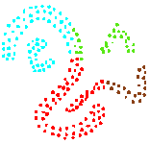
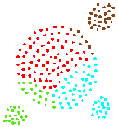
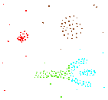
Density-Based Clustering
Basic Idea:
  Clusters are dense regions in the data space, separated by regions of lower object density
Why Density-Based Clustering?
Results of a k-medoid
algorithm for k=4
Different density-based approaches exist (see Textbook & Papers)
Here we discuss the ideas underlying the DBSCAN algorithm

Slide 4
Density Based Clustering: Basic Concept
Intuition for the formalization of the basic idea
  For any point in a cluster, the local point density around that point has to exceed some threshold
  The set of points from one cluster is spatially connected
Local point density at a point p defined by two parameters
  ε – radius for the neighborhood of point p:
  N_{ε} (p) := {q in data set D | dist(p, q) ≤ ε}
  MinPts – minimum number of points in the given neighbourhood N(p)

Slide 5
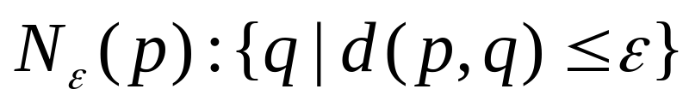
ε-Neighborhood
ε-Neighborhood – Objects within a radius of ε from an object.
“High density” - ε-Neighborhood of an object contains at least MinPts of objects.
ε-Neighborhood of p
ε
ε
ε-Neighborhood of q
q
p
Density of p is “high” (MinPts = 4)
Density of q is “low” (MinPts = 4)

Slide 6
Core, Border & Outlier
Outlier
Given ε and MinPts, categorize the objects into three exclusive groups.
Border
A point is a core point if it has more than a specified number of points (MinPts) within Eps These are points that are at the interior of a cluster.
  A border point has fewer than MinPts within Eps, but is in the neighborhood of a core point.
  A noise point is any point that is not a core point nor a border point.
Core
ε = 1unit, MinPts = 5

Slide 7
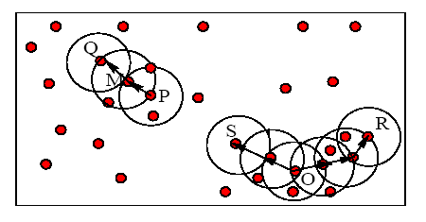
Example
M, P, O, and R are core objects since each is in an Eps neighborhood containing at least 3 points
Minpts = 3
Eps=radius of the circles

Slide 8
Density-Reachability
Directly density-reachable
  An object q is directly density-reachable from object p if p is a core object and q is in p’s ε-neighborhood.
q is directly density-reachable from p
p is not directly density- reachable from q?
Density-reachability is asymmetric.
ε
ε
q
p
MinPts = 4

Slide 9
Density-reachability
Density-Reachable (directly and indirectly):
  A point p is directly density-reachable from p2;
  p2 is directly density-reachable from p1;
  p1 is directly density-reachable from q;
  p←p2←p1←q form a chain.
p
p is (indirectly) density-reachable from q
q is not density- reachable from p?
p₂
p₁
q
MinPts = 7

Slide 10
Density-Connectivity
Density-reachable is not symmetric
  not good enough to describe clusters
Density-Connected
  A pair of points p and q are density-connected if they are commonly density-reachable from a point o.
Density-connectivity is symmetric
p
q
o

Slide 11
Formal Description of Cluster
Given a data set D, parameter ε and threshold MinPts.
A cluster C is a subset of objects satisfying two criteria:
  Connected:  p,q C: p and q are density-connected.
  Maximal:  p,q: if p C and q is density-reachable from p, then q C. (avoid redundancy)
P is a core object.

Slide 12
Review of Concepts
Is an object o in a cluster or an outlier?
Are objects p and q in the same cluster?
Are p and q density-connected?
Is o a core object?
Is o density-reachable by some core object?
Are p and q density-reachable by some object o?
Directly density-reachable
Indirectly density-reachable through a chain

Slide 13
DBSCAN Algorithm
Input: The data set D
Parameter: ε, MinPts
For each object p in D
if p is a core object and not processed then
C = retrieve all objects density-reachable from p
mark all objects in C as processed
report C as a cluster
else mark p as outlier
end if
End For
  DBScan Algorithm

Slide 14
DBSCAN: The Algorithm
  Arbitrary select a point p
  Retrieve all points density-reachable from p wrt Eps and MinPts.
  If p is a core point, a cluster is formed.
  If p is a border point, no points are density-reachable from p and DBSCAN visits the next point of the database.
  Continue the process until all of the points have been processed.

Slide 15
DBSCAN Algorithm: Example
Parameter
    ε = 2 cm
    MinPts = 3
for each o ∈ D do
if o is not yet classified then
if o is a core-object then
collect all objects density-reachable from o
and assign them to a new cluster.
else
assign o to NOISE

Slide 16
DBSCAN Algorithm: Example
Parameter
    ε = 2 cm
    MinPts = 3
for each o ∈ D do
if o is not yet classified then
if o is a core-object then
collect all objects density-reachable from o
and assign them to a new cluster.
else
assign o to NOISE

Slide 17
DBSCAN Algorithm: Example
Parameter
    ε = 2 cm
    MinPts = 3
for each o ∈ D do
if o is not yet classified then
if o is a core-object then
collect all objects density-reachable from o
and assign them to a new cluster.
else
assign o to NOISE

Slide 18
MinPts = 5
ε
P₁
ε
ε
C₁
P
P
C₁
C₁
1. Check the ε-neighborhood of p;
2. If p has less than MinPts neighbors then mark p as outlier and continue with the next object
3. Otherwise mark p as processed and put all the neighbors in cluster C
1. Check the unprocessed objects in C
2. If no core object, return C
3. Otherwise, randomly pick up one core object p₁, mark p₁ as processed, and put all unprocessed neighbors of p₁ in cluster C

Slide 19
ε
ε
C₁
C₁
ε
ε
ε
C₁
C₁
C₁

Slide 20


Example
Original Points
Point types: core, border and outliers
ε = 10, MinPts = 4

Slide 21

When DBSCAN Works Well
Original Points
Clusters
Resistant to Noise
Can handle clusters of different shapes and sizes

Slide 22



When DBSCAN Does NOT Work Well
(MinPts=4, Eps=9.92).
Original Points
Cannot handle Varying densities
sensitive to parameters
(MinPts=4, Eps=9.75)

Slide 23



DBSCAN: Sensitive to Parameters

Slide 24
Determining the Parameters ε and MinPts
Cluster: Point density higher than specified by ε and MinPts
Idea: use the point density of the least dense cluster in the data set as parameters – but how to determine this?
Heuristic: look at the distances to the k-nearest neighbors
Function k-distance(p): distance from p to the its k-nearest neighbor
k-distance plot: k-distances of all objects, sorted in decreasing order
p
3-distance(p) :
q
3-distance(q) :

Slide 25
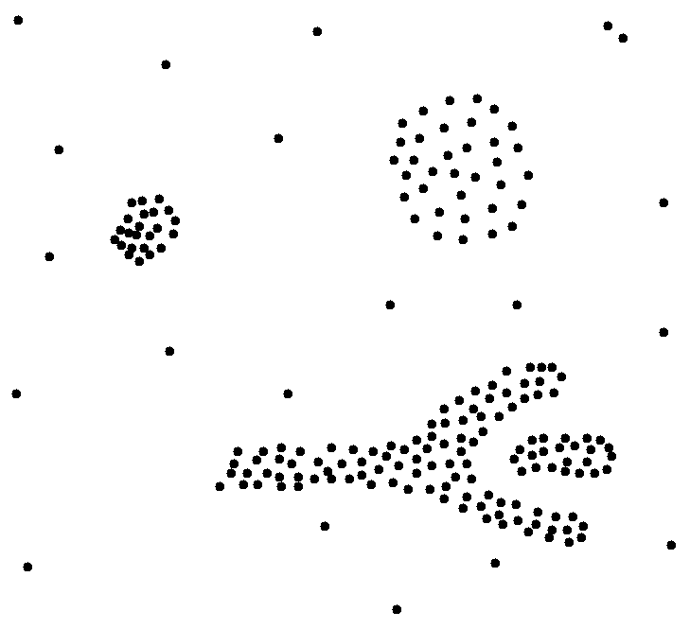
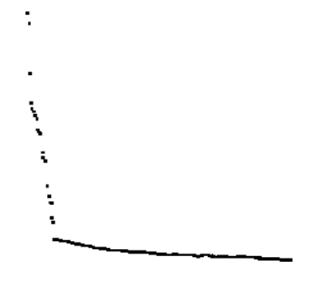
Determining the Parameters ε and MinPts
Example k-distance plot
Heuristic method:
  Fix a value for MinPts (default: 2 × d –1)
  User selects “border object” o from the MinPts-distance plot;
  ε is set to MinPts-distance(o)
3-distance
first „valley“
Objects
„border object“

Slide 26
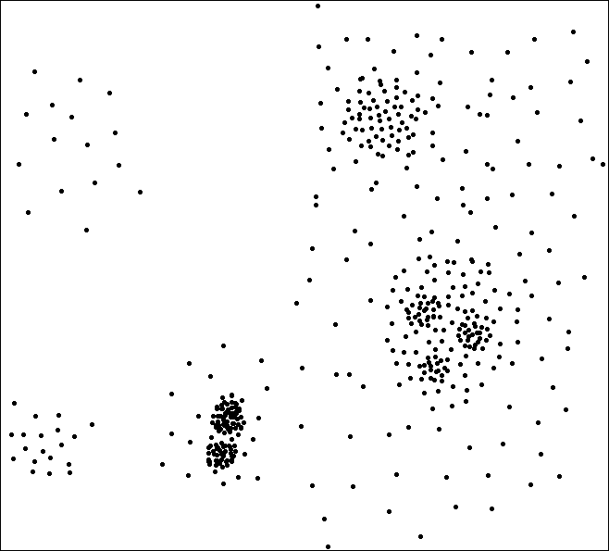
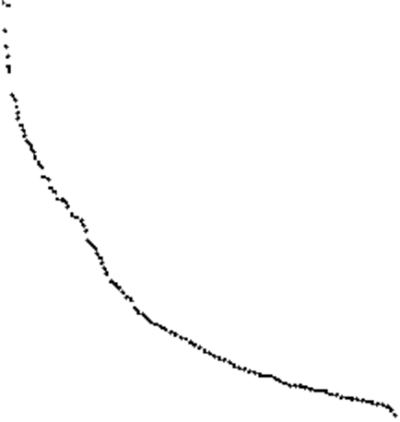
Determining the Parameters ε and MinPts
Problematic example
A
C
F
E
A, B, C
B, D, E
G
3-Distance
B‘, D‘, F, G
G1
G3
D1, D2,
G1, G2, G3
B
D
G2
D’
B’
D1
Objects
D2

Slide 27
Density Based Clustering: Discussion
Advantages
  Clusters can have arbitrary shape and size
  Number of clusters is determined automatically
  Can separate clusters from surrounding noise
Disadvantages
  Input parameters may be difficult to determine
  In some situations very sensitive to input parameter setting

